Slide 1



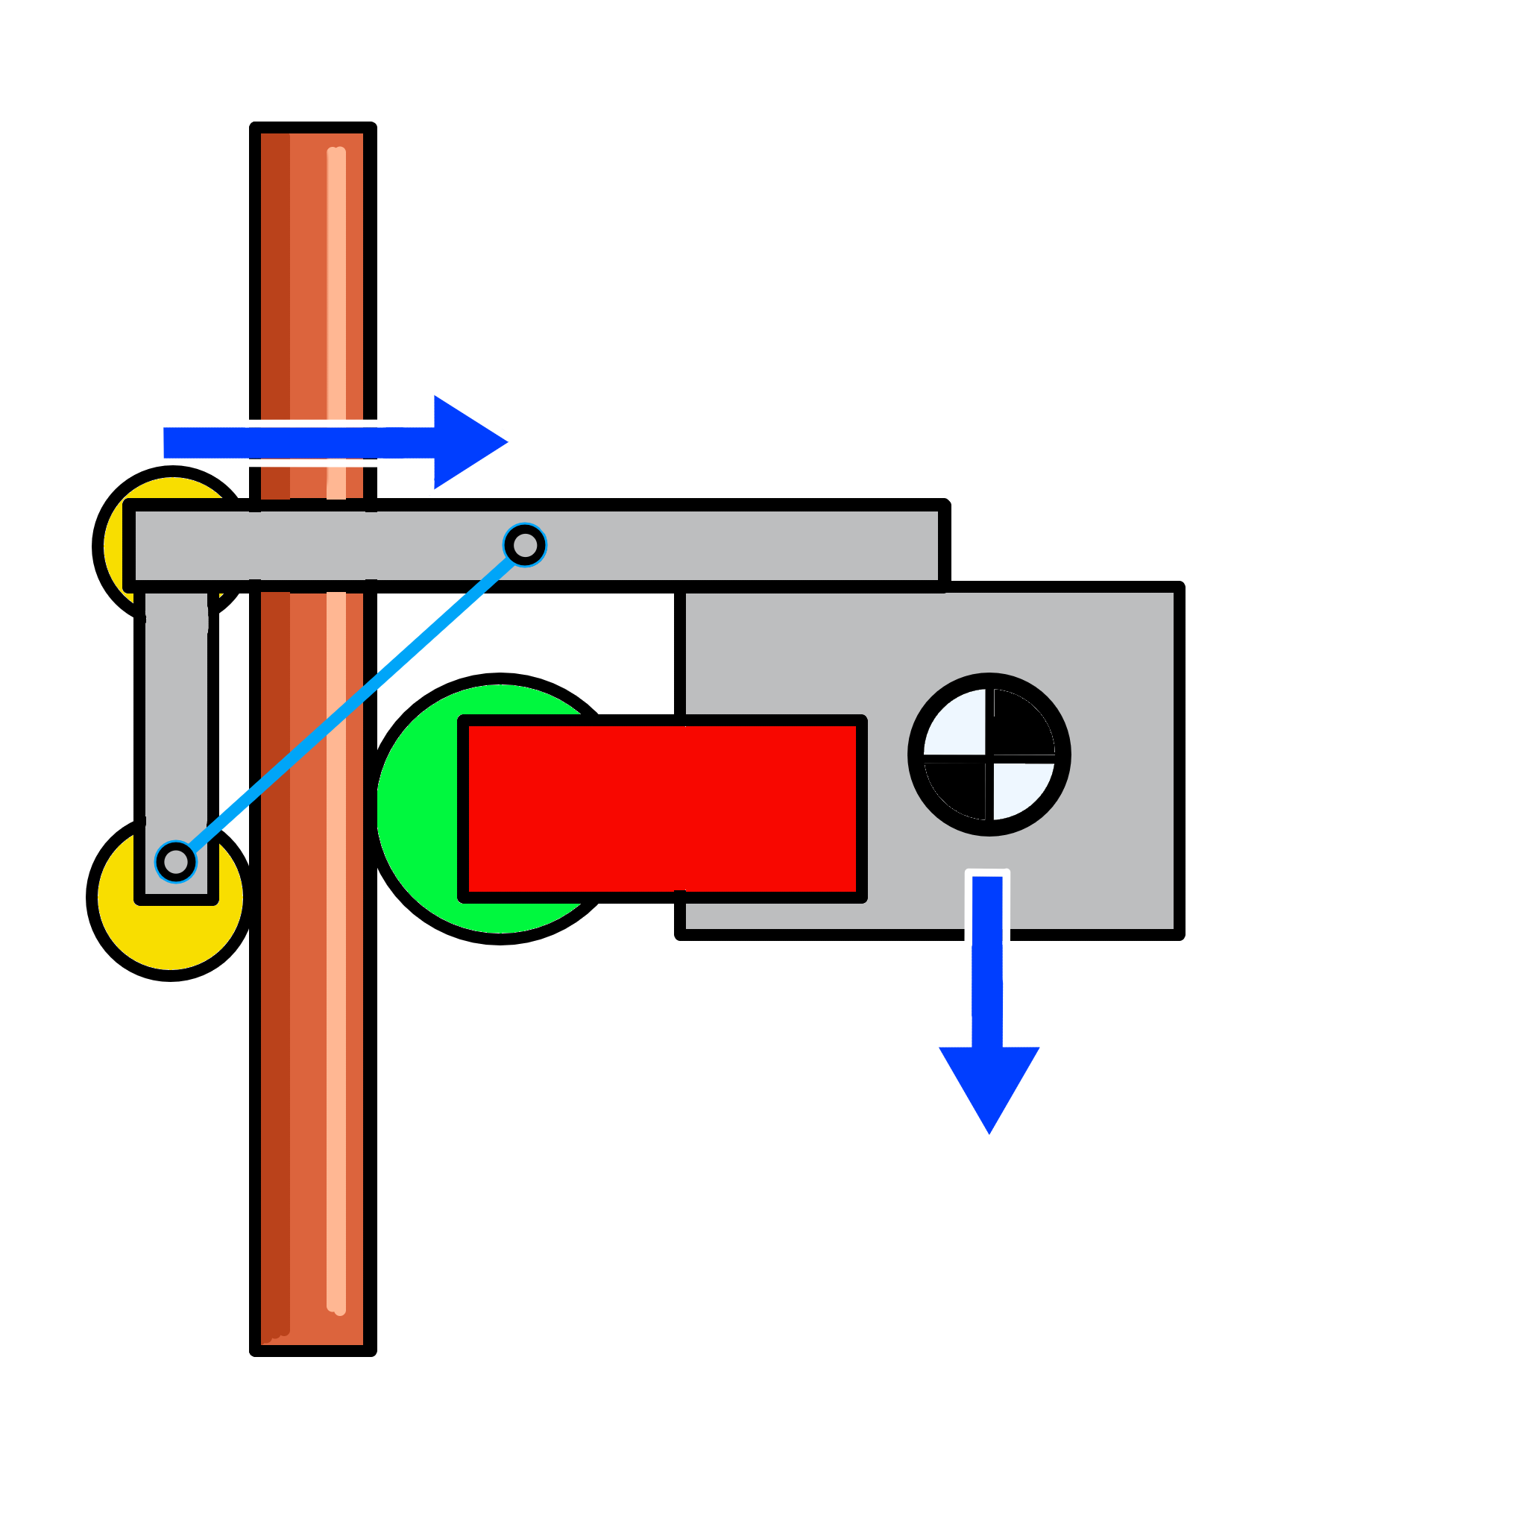
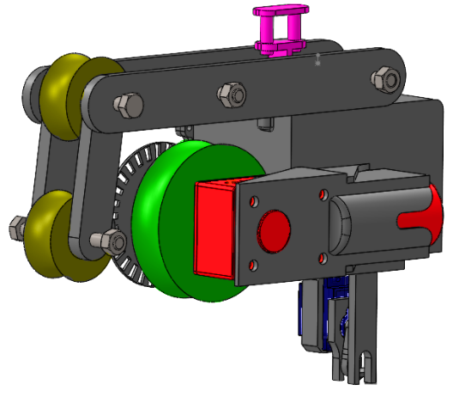
Pipe climbing robot for the IMechE design challenge of the Wessex Regional Final 2026
Team name: Pipe Dream
Team members:
-Damien Akers
-Joshua Pepple
-Marley Williams
-Saef Al Barazi
Main design parameters/description:
-using weight offset to cling onto the pipe
-3D printed PLA for chassis and housing
-driven by a single 12v DC motor with an rpm of 200
-Arduino nano for logic control
Competition parameters/goal:
-Climb a 22mm diameter copper pipe until reaching the top
-Carry a chain, dropping it at the midway point of the pipe
-Activate a Green LED when the robot is active
-Activate a red LED and a buzzer when top is reached
Moment due to center of mass offset
Information:
• CAD mass: 787 grams not counting Arduino and h-bridge
• 12v DC motor with worm gears
• Dual H bridge motor XY-160D
•Total cost, including consumables (IMechE specified): £78.91
center of mass
Component | Role | Selection Justification
Arduino Nano R4 | Central Logic | Lightweight, High-speed
XY-160D H-Bridge | Motor Driver | High current capacity
Worm Gear Motor | Primary Actuator | Self-locking to prevent sliding
Optical Encoder | Distance Feedback | Provides precision tick for finding distance
7809CT Regulator | Power Management | Stabilises the 18v battery input into 9V for Arduino
Advantages | Disadvantages
No more than one motor required | If centre of mass is not in line with the pipe on the z axis, robot will rotate as it climbs
Integrated gear box with self locking worm gears means no power required to maintain robots position | Maintenance / replacement of electrical components is difficult. Design oversight
3D printed PLA chassis is inexpensive outside competition specification | If using standard 9v alkaline batteries, frequent replacement is needed as voltage drops over continuous use
Further mass addition will not cause robot to slip | Time consuming to install and remove
Although not utilised, design can incorporate an optical encoder for accurate robot movement through PID | Parts cannot be easily disassembled, entire chassis needs to be reprinted as a result. Design oversight
Push Button
Motor
Driven Wheel
Non-driven Wheels
Chain Servo

